Slide 1

Statistical and Predictive Modeling for Analytics II
Assignment – 3
Discriminant Analysis
Presented By
Kartik Sojitra (100723768)

Slide 2

Table of Contents
Description of the Problem
Data Evaluation
Learning Curve of the LDA Model
SMOTE
Standard and Optimized LDA Model
Comparison of Results
Recommendations

Slide 3

Description of the Problem
Mr. John Hughes is examining how the optimized Logistic regression model and optimized LDA model would better help to distinguish different independent variables that are affecting the dependent variable (Class).
To solves the above problem we are using cancer2.csv dataset and creating a standard and optimized logistic regression model.
Furthermore, the dataset is likely to be more difficult by analyzing the independent variables and the dependent variable.
In the dataset, there are 10 independent variables (id, Clump Thickness, UofCSize, UofCShape, Marginal Adhesion, SECSize, Bare Nuclei, Bland Chromatin, Normal Nucleoli, Mitoses) and 1 dependent variable (CMS).

Slide 4
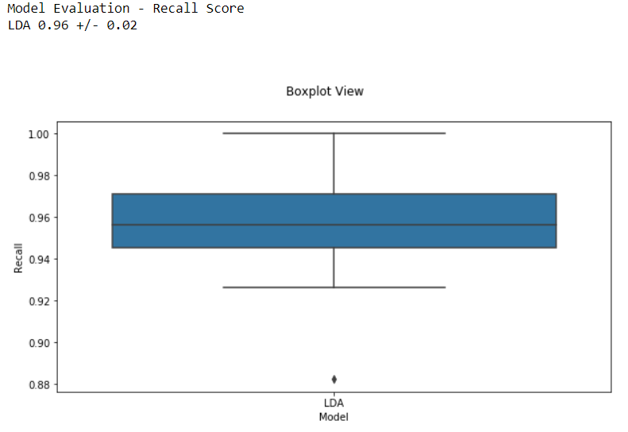
Model Evaluation - Recall Score LDA 0.96 +/- 0.02
Data Evaluation
Std = 0.95
Mean = 2.69
Min = 2.00
Max = 4.00
For those factors who’s mean and, the standard deviation is high they influence the Class to affect most as compares to a variable whose gap is little.
There is normal distribution in data with one outlier which are shown in the box plot.
Con’t…

Slide 5
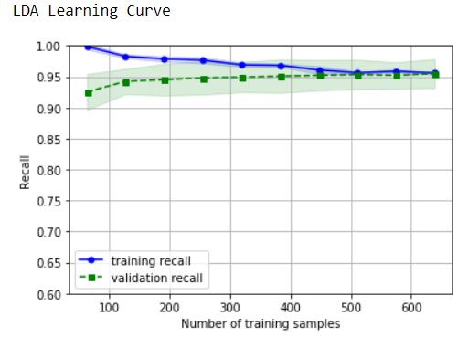
Learning Curve of the LDA Model
X = Number of training samples
Y = Recall
alpha = 0.15
random_state = 100
cv = 10
n_jobs = 1
R2 = 0.90
Mean Absolute Error = 0.04
Mean Squared Error = 0.09
Root Mean Squared Error = 0.30
Con’t…

Slide 6
The LDA learning curve compares the performance of a model on training and testing data over a varying number of training instances.
The gap between the training and validation recall is decreasing consistently which represents how well the model can generalize to new data.
We can determine from the graph that no issue of overfitting and underfitting which illustrates that good bias-variance trade-off that means model learning consistently and performance of model improves as the number of training points increases.
Here our y-axis is ‘Recall', not ‘SCORE', so the higher the Recall, the better the performance of the model.

Slide 7


SMOTE
SMOTE is Synthetic Minority Oversampling Technique. This is a statistical technique for improving the number of cases in cancer.csv dataset in a balanced way.
The module accomplishes by creating new examples from being oversampling (minority) cases that we provide as input. This implementation of SMOTE does not change the number of majority events.
We had an imbalanced dataset and change it into a balanced dataset using SMOTE and run the LDA model.
Standard and Optimized Regression model
Standard and Optimized Regression model
Standard and Optimized Regression model

Slide 8
Standard and Optimized LDA model
In the standard LDA model we are going to identify how different independent variables are affecting the dependent variable (Class) and each number is treated as a weight and the sign (+ or -) is the average effect on Class.
For those factors who’s mean and, the standard deviation is high they influence the Class to affect most as compares to a variable whose gap is little.
The value of root mean squared error is 0.30, which is less than 15% of the mean value of the percentages of Class (i.e. 2.69) which implies our algorithm was exceptionally exact but make a very great prediction.
This model clarifies the division of the fluctuation between the quantities anticipated by the model and the value as opposed to the mean of the actual. This value is between 0 and 1.

Slide 9
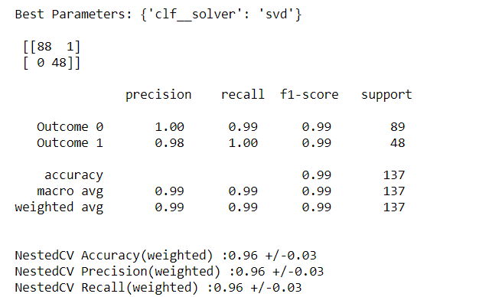
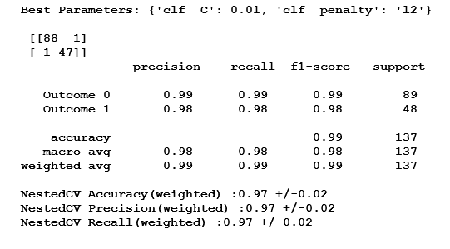
Comparison of Results
Optimized Regression Model:
Optimized LDA Model:
:
Con’t…

Slide 10
The optimized regression model and optimized LDA model has 99% accuracy which depicts that both models are more accurate to perform discriminant analysis.
Optimized LDA model has a higher recall value of 99% and 100% for outcome 0 and outcome 1 that is higher than the optimized regression model that means it is predicted 99% and 100% accurate positive observations to all observations in an actual class.
NestedCV for optimized regression model and optimized LDA model is 0.97 +/- 0.02 and 0.96 +/- 0.03 respectively which is often used to train a model in which hyperparameters also need to be optimized.
Con’t…

Slide 11
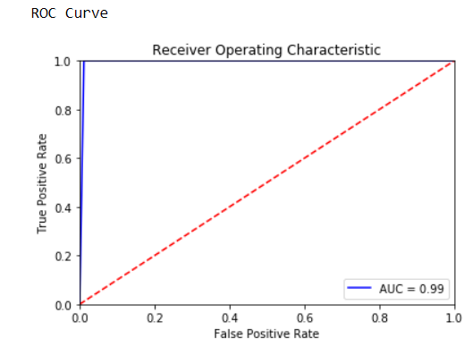
ROC Curve
The area included by the curve is the area within the blue line (ROC) and the axis called Area Under Curve (AUC).
The value of AUC for the optimized LDA model is 0.99.
The area covered under the curve is greater for the optimized LDA model that represents better the model is at distinguishing the given classes.

Slide 12
Recommendation
Optimized regression model and optimized LDA model, both have a higher recall value and f1- a score which depicts that both models are more accurate to perform discriminant analysis.
Also, the optimized LDA model has f1-score 0.99 which is quite higher compared to the optimized regression model, but Mr. John Hughes should use an optimized regression model to perform analysis because it is simple model and perform well in large dataset.
To improve the accuracy of optimizing the LDA model Mr. John Hughes can collect more training data, reduce the complexity of the model.
To improve the f1 score and recall value Mr. John Hughes can transform and modify the dataset.

Slide 13


